Slide 1
Week 01, Day 02
HTML
CodeSLO 2018

Slide 2
Using Visual Studio Code

Slide 3
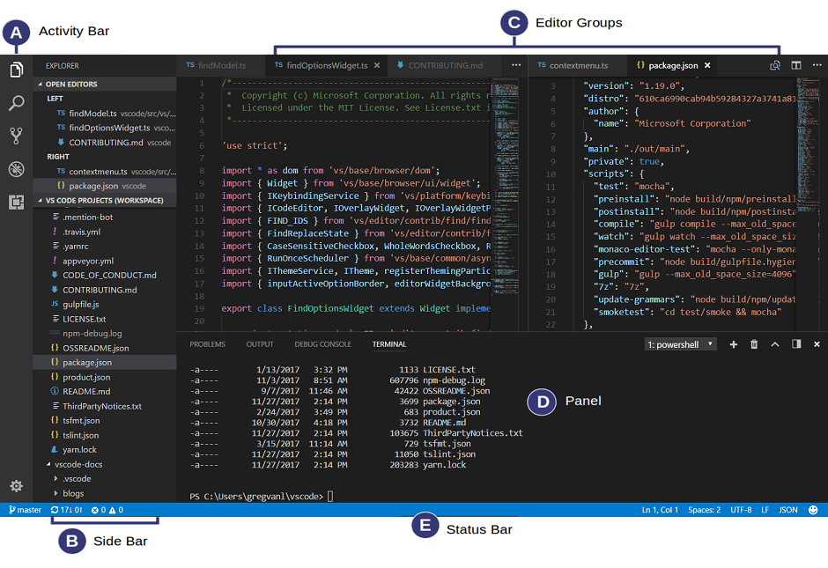

Slide 4
The Activity Bar
Let’s take a look at some of the options available to us on the activity bar.

Slide 5
The Sidebar
Let’s use the sidebar to create folders and files

Slide 6
The Editor
Let’s enter some basic HTML into the editor so we can see some of its features.

Slide 7
The Console
The console is a great feature of VS Code and a very convenient one.

Slide 8
Let’s Write Some Code

Slide 9
What is coding?
“Coding” is using any sort of structured language to tell a computer what to do. This could mean programming in JavaScript or describing content in HTML.
A common question goes like this: “Is coding the same as programming?”
The answer: All programming is coding, but not all coding is programming.

Slide 10
You Learn to Code by Coding
What we’re going to learn in this course are the basics of web development.
Web Development is programming for the web. It encompasses everything from basic HTML to the sophisticated real-time interaction of a multiplayer video game.
There’s a lot we can - and will - say about web development but at the end of the day coding, like playing a musical instrument, is something you learn by doing.

Slide 11
HTML
HTML - short for Hypertext Markup Language - describes content on the web.
HTML isn’t a programming language because it doesn’t provide complex functionality like loops or decision making. It is a markup language that tells browsers what to display.
HTML is fairly simple. It doesn’t even tell a browser what style content should have, just what content is there.
Let’s write some!

Slide 12
Exercise One
Create a folder on your computer called “Session One”
Open it in VS Code and create a new file called index.html
In the editor window make sure you have index.html selected and type the following:
<h1>This is a heading element</h1>
<h2>This is a subheading element</h2>
<p>This is a paragraph element</p>

Slide 13
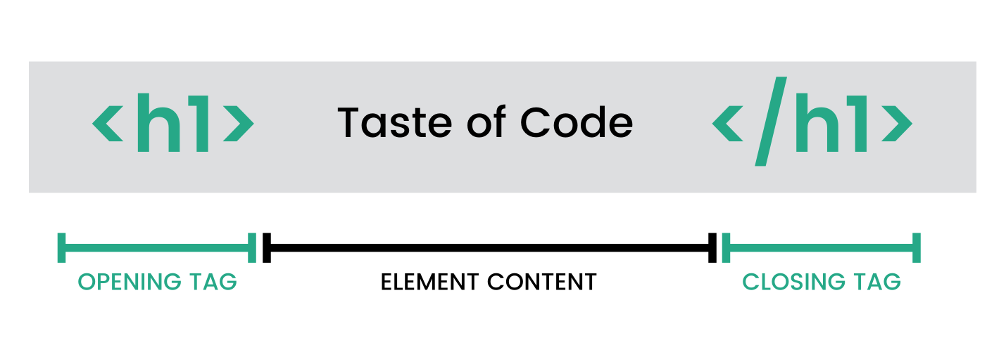
Opening and Closing Tags

Slide 14
Time to Check In!

Slide 15
Exercise Two: Open the File in a Browser
Save your file
In your explorer or finder, open your index.html file with the Chrome browser.

Slide 16
Exercise Three: Add a Link to Another Webpage
Add the code below to index.html
Save and test your code. Clicking the link should take you to our Meetup page.
<a href="https://meetup.com/codeslo"><p>This is an anchor element, AKA a link</p></a>

Slide 17
HREF
You’ll notice that when we included our anchor link, we had to tell the browser where it linked to. This is indicated by the href property. Href is short for Hypertext Reference.
There are many, many properties that can be included inside the opening HTML tag. HREF is a common one.

Slide 18
Images
There are two ways to add an image to your page. The first is to link to an image that is already online via a URL, the other is to add an image that is stored in the file system of your web server.

Slide 19
Exercise Four: Add an image from the web
Do a quick Google search for an image of anything. Kittens, space monkeys, ice cream… whatever you want.
Copy the URL for your image. Make sure you have the image URL, not the URL for the search result.
Add the following code:
<img src="<paste your image URL here>" />

Slide 20
Wait! My image is too big!
Depending on the image you grabbed, it might display WAY too big on your page. We’ll tame it with a sneak peak at CSS.
Modify your img tag to look like this:
<img style="width:300px" src="<paste your image URL here>" />

Slide 21
Img tags are weird
Img (image) tags are weird.
They use the src (source) property. This is very similar to the href property and is used the same way.
They don’t have a normal closing tag because there isn’t ever anything you’d want to put between those tags
Instead, img is a self-closing tag, indicated by the /> at the end.

Slide 22
Exercise Five: Add a Local image
Choose an image you have on your computer already, or download a new one.
Copy that image and paste it into the project folder for your web page.
Rename the image to something simple and descriptive like “space-monkey-pic.jpg” Make sure to avoid using spaces in your file name.

Slide 23
Exercise Five (cont.)
4. Change your img tag to look like this:
<img style="width:300px" src="space-monkey-pic.jpg” />

Slide 24
Your First Web Page
In our next exercise, we will begin to work on our first web page.
For many of you, that page will be “How to Google.”
For those of you that have already built that project in another CodeSLO course, you can do a substitute project called “How to use MDN.” This page should be about using the Mozilla Developers Network.
Our examples will show the “How to Google” page.

Slide 25
Exercise Six: How to Google
Now the fun part. You get to make your first web page.
Create a new file called how-to-google.html
Since so many people in the world don’t seem to know how to use Google, think about a paragraph or two that might help them out.
Build a webpage using <h1>, <h2>, <p>, <img>, and <a> tags. Inside the <p>Tags, add your paragraphs about how to Google. Try to include at least four paragraphs. This will be important for styling later. We need text!

Slide 26
questions?

Slide 27
Next Session
Next Session we’ll be building on what we did today.
We’ll go over more HTML and we’ll style it using CSS
Till then...

Slide 28
Code On!

